Slide 1

Mending Gaps for the promotion of recovery and resilience in mental health
Helen Casey, Open University, UK
Cecilia Heule, Lund University, Sweden
www.powerus.eu

Slide 2
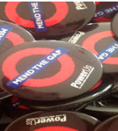
Gap-mending is an approach that enables students, practitioners, teachers, people in receipt of sevices and researchers in social work to reflect upon what, in social work practice, increases, maintains or mends gaps between professionals and people in receipt of support.
Mend the Gap programmes are co-produced, challenge existing structures for involvement.
Increased involvement of most marginalised, excluded voices.
Focus on outcomes – what difference does involvement make?
PowerUs, an established network since 2012 working with Higher Education Institutions and community partner organisations in over 20 countries , who engage in gap mending practices. PowerUs | PowerUs
http

Slide 3
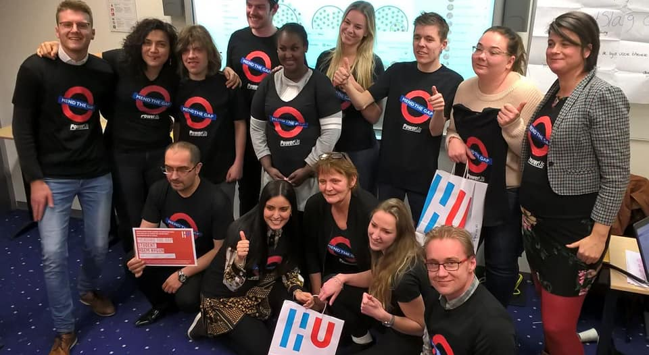
Powerus
www.powerus.eu

Slide 4
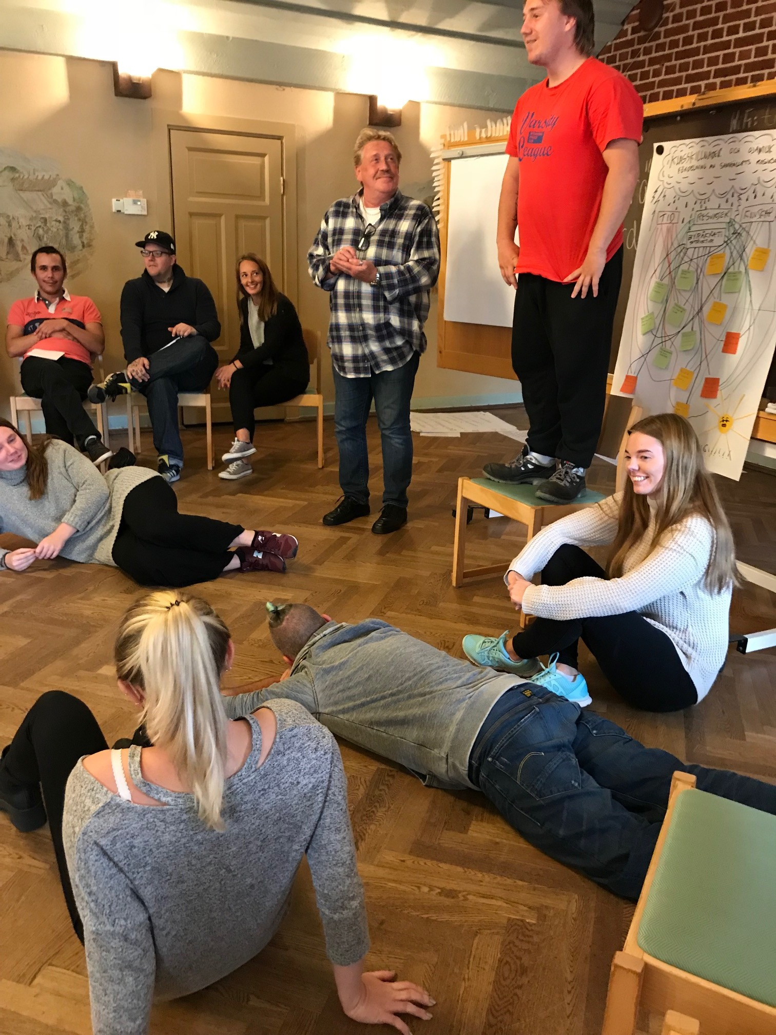
The mobilization course
Elective course in the last semester of the bachelor's programme in social work/ Commissioned education
6 joint weeks, 7.5 points
32 Courses since 2005
700 social work students and 300 students from different service user organizations
They learn from each other's experiences and develop joint project ideas under supervision
Since 2008 about 30 teachers employed on other courses, in semesters one, four and seven. These are recruited from the external students of the mobilization course.

Slide 5
Some historical criticism
Michel Foucault: The history of madness
Erving Goffman: Total Institutions
Films like: One flew over the Cuckoos nest.

Slide 6
Response from the service users
Foutain house movement
The Recovery movement
AA-movement
The diability rights movement
The feminist and antirascist movements

Slide 7
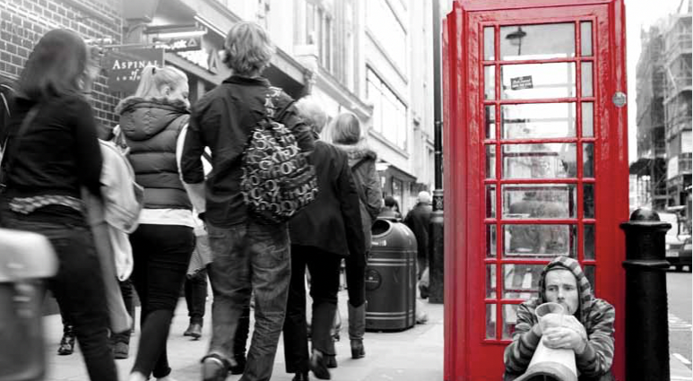
Social Exclusion
… is a process where different groups in society are excluded from finacial, social cultural and political resurces and rights.

Slide 8

Social inclusion.
Who risk being excluded?
People with mental illness
Persons who have long-term experience of addiction and/or criminality
Persons with disabilities
Refugees, or children of immigrants who have not had good opportunities to integrate.
Children who grow up with violence, bullying, substance abuse, financial vulnerability or mental illness.

Slide 9
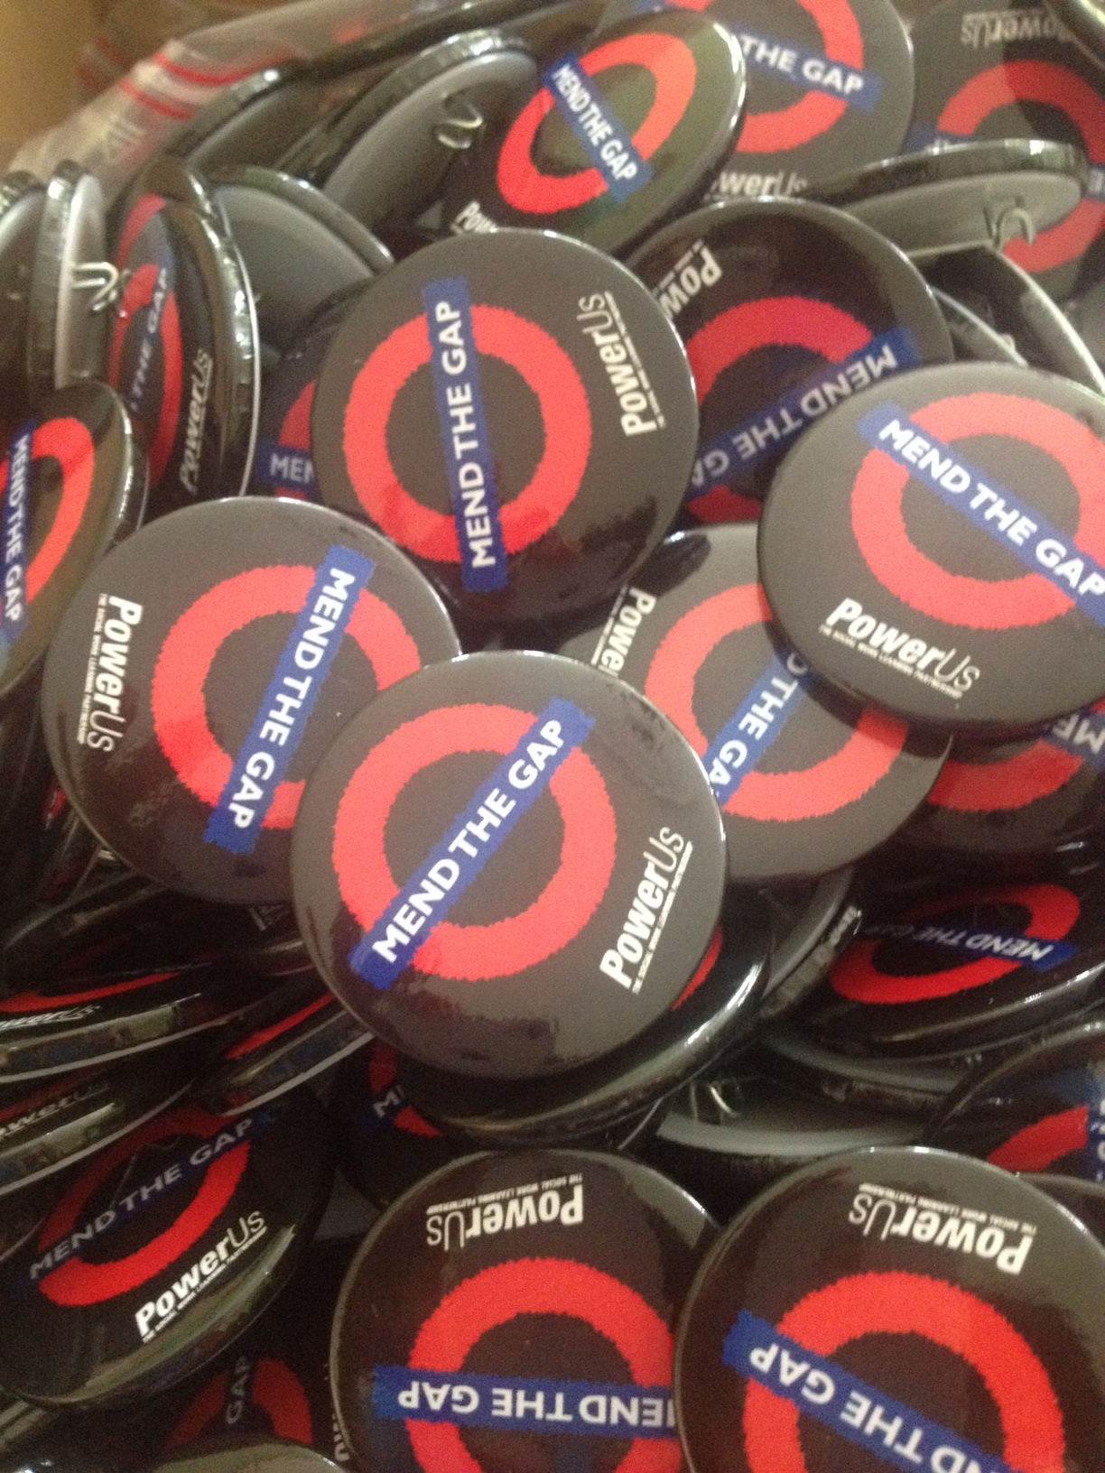
Nine faculties
How do we mend the gaps in social work practice and education?

Slide 10
Gaps limiting social work
Between social workers and service users.
Between expert knowledge and knowledge that comes from service users experiences.
Between social work practice and social work education.
Between researchers and those who are researched.

Slide 11
Mending gaps with marginalised communities
Gap mending programmes in the UK since 2014
With parents who have had their children removed by social workers
Migrant communities – parents and unaccompanied minors
-Disabled adults with mental health distress
-Learning disabled adults
-Young adult learners with mental health difficulties
-Parents with experience of psychosis during childbirth

Slide 12

co-producing the educational curriculum
Co-designing course content including range of audio and visual resources
Working with community partners to identify gaps in professional learning
Co-education roles in teaching and assessment
Co-leadership in research centre developments

Slide 13

Example of new co-produced resource

Slide 14
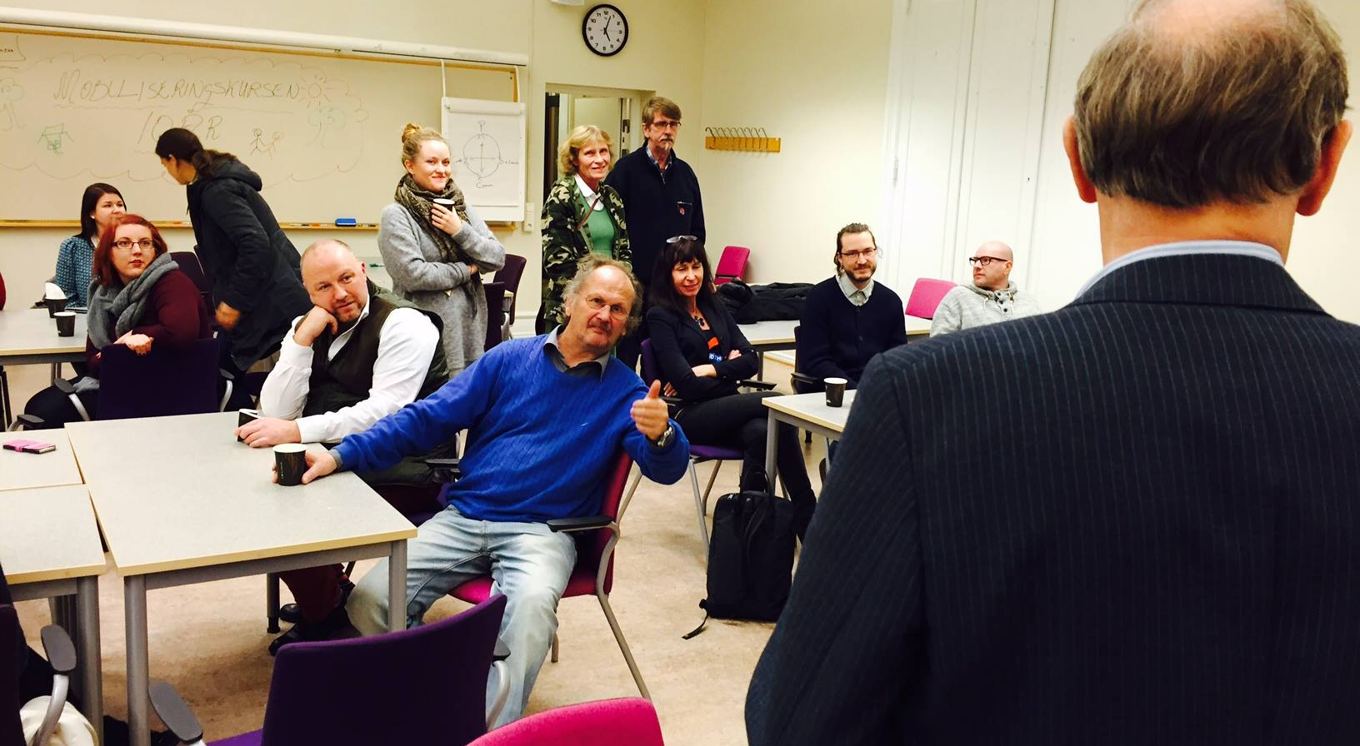
Dikotomies and shame
Important to understand the mechanisms!

Slide 15
Many students carry experiences of:
Mental illness
Drug or alcohol abuse
Having a diagnose
Having lived with violence and abuse
Migration
Poverty
Having been bullied in school
Having lived in foster care
Having lost a close family member
Having had physical disabilities

Slide 17


The intergroup contact research how can we design encounters that decreases prejudice?
Four components
Three strategies to handle categorisation:
Equal status
Co-operation
Common goals
Institutional support
Personal sharing
Time
Categorisation
Decategorisation
Recategorisation

Slide 18
ReferENCES
Askheim, Ole-Petter, Beresford, Peter & Heule, Cecilia (2017) Mend the gap – strategies for user involvement in social work education, in Social Work Education, 36 (2) s 128 – 140
Allport, Gordon (1954) The nature of prejudice. Reading: Addison-Wesley
Heule, Cecilia (2021) Iscensatt inkludering. Gemenskap som mål och utmaning på socionomutbildningen, Lund dissertations in social work, Lund University
Heule, Cecilia Knutagård, Marcus & Kristiansen, Arne. Mending the gaps in social work education and research, in European journal of Social Work 20 (3), 2017: 396 – 408.
Karbouniaris, Simone; Abma, Tineke; Wilken, Jean Pierre och Weerman, Alie. Use of experimental knowledge by mental health professionals and its contribution to recovery: literature review. Journal of Recovery in Mental Health. Vol. 4, No 1. 2020
McLaughlin, Hugh; Beresford, Peter; Casey, Helen & Duffy, Joe (red) The Routledge Handbook of Service User Involvement in Human Services Research and Education. New York: Routledge, 2021
Pettigrew, Thomas & Tropp, Linda. When Groups Meet. The Dynamics of Intergroup Contact, New York: Psychology Press, 2011

Slide 19

Thankyou for listening, any questions?
Cecilia.heule@soch.lu.se.
Helen.casey@open.ac.uk

